Slide 1

The Smart AI Helmet
An Intelligent System to Prevent Accidents and Instantly Save Lives
Project By : Ayush, Aviral, Ayush Chaudhary, Avni
Roll Number: 2420688, 2420686,2420689,2420687
Branch & Group : AI & DS , B
Chandigarh Engineering College Jhanjeri

Slide 2

The Critical Challenge We're Solving
Two-Wheeler Safety Crisis
Every year, thousands of motorcyclists lose their lives due to preventable accidents. The primary culprits? Human error, impaired riding, and critically delayed emergency response.
Traditional safety measures rely entirely on rider discipline and luck. When accidents happen, every second counts—but help often arrives too late.

Slide 3




Our Smart Solution: Prevention Meets Instant Response
Zero Alcohol Start
Mandatory Helmet Check
MQ-3 sensor detects alcohol in rider's breath and automatically locks bike ignition—eliminating drunk driving before it starts.
Integrated sensor verifies helmet is properly worn and secured before allowing the motorcycle engine to start.
Instant Crash Detection
Automated GPS Alert
MPU6050 motion sensor identifies sudden impacts or falls in real-time, triggering immediate emergency protocols.
GSM module instantly transmits exact accident coordinates to emergency contacts, family members, and nearby hospitals.

Slide 4
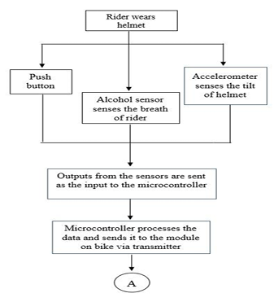
The Technology Architecture
01
Safety Check Initiation
Arduino microcontroller reads helmet sensor and MQ-3 alcohol sensor data to verify rider readiness.
02
Ignition Control
If both safety checks pass, the relay module activates and enables the motorcycle's ignition system.
03
Continuous Monitoring
MPU6050 accelerometer constantly tracks motion patterns, analyzing for sudden impact signatures during the ride.
04
Emergency Protocol
Upon crash detection, buzzer alarm activates while GPS/GSM module transmits location coordinates to saved emergency contacts.

Slide 5






Component Breakdown: The Hardware Behind Safety
Arduino Uno
Arduino Uno
MQ-3 Alcohol Sensor
MQ-3 Alcohol Sensor
The central processing unit that orchestrates all sensor inputs, makes safety decisions, and controls the relay system in real-time.
Highly sensitive breath analyzer that measures blood alcohol concentration with 95.7% accuracy to prevent impaired riding.
MPU6050 Accelerometer
Relay Module
MPU6050 Accelerometer
Relay Module
6-axis motion tracking sensor that detects crashes, falls, and sudden impacts with 92.7% precision through advanced motion analysis.
Electronic switching mechanism that controls motorcycle ignition, acting as the physical enforcement of safety protocols.
GPS/GSM Module
Buzzer Alarm
GPS/GSM Module
Buzzer Alarm
Dual-function communication system that pinpoints exact location coordinates and transmits emergency alerts via cellular network.
High-decibel audio alert system that sounds during emergencies to attract immediate attention from nearby people.

Slide 6

How It Works: The Safety Loop
Helmet & Sensor Check
Alcohol & Arduino Decision
Relay Ignition Control
MPU6050 Crash Alert
Our system creates a seamless safety net that operates automatically—removing human error from critical safety decisions while maintaining constant vigilance throughout every ride.

Slide 7
Proven Results: Fast, Accurate, Life-Saving
92.7%
95.7%
Real-World Impact
Our prototype demonstrates that cutting-edge safety technology doesn't require a premium price tag. By dramatically reducing emergency response time and enforcing safety rules automatically, the Smart AI Helmet addresses the root causes of motorcycle fatalities.
Accident Detection
Alcohol Detection
Highly reliable identification of crash events and sudden impacts
Exceptional accuracy in preventing impaired riding attempts
8.2s
$45
The system removes human judgment from safety decisions—making compliance automatic rather than optional.
Emergency Alert Speed
Total System Cost
From crash detection to emergency notification delivery
Affordable solution accessible for widespread adoption
67%
100%
Response Time Improvement
Safety Compliance
Faster than conventional emergency response methods
Mandatory helmet use and sober riding enforcement

Slide 8
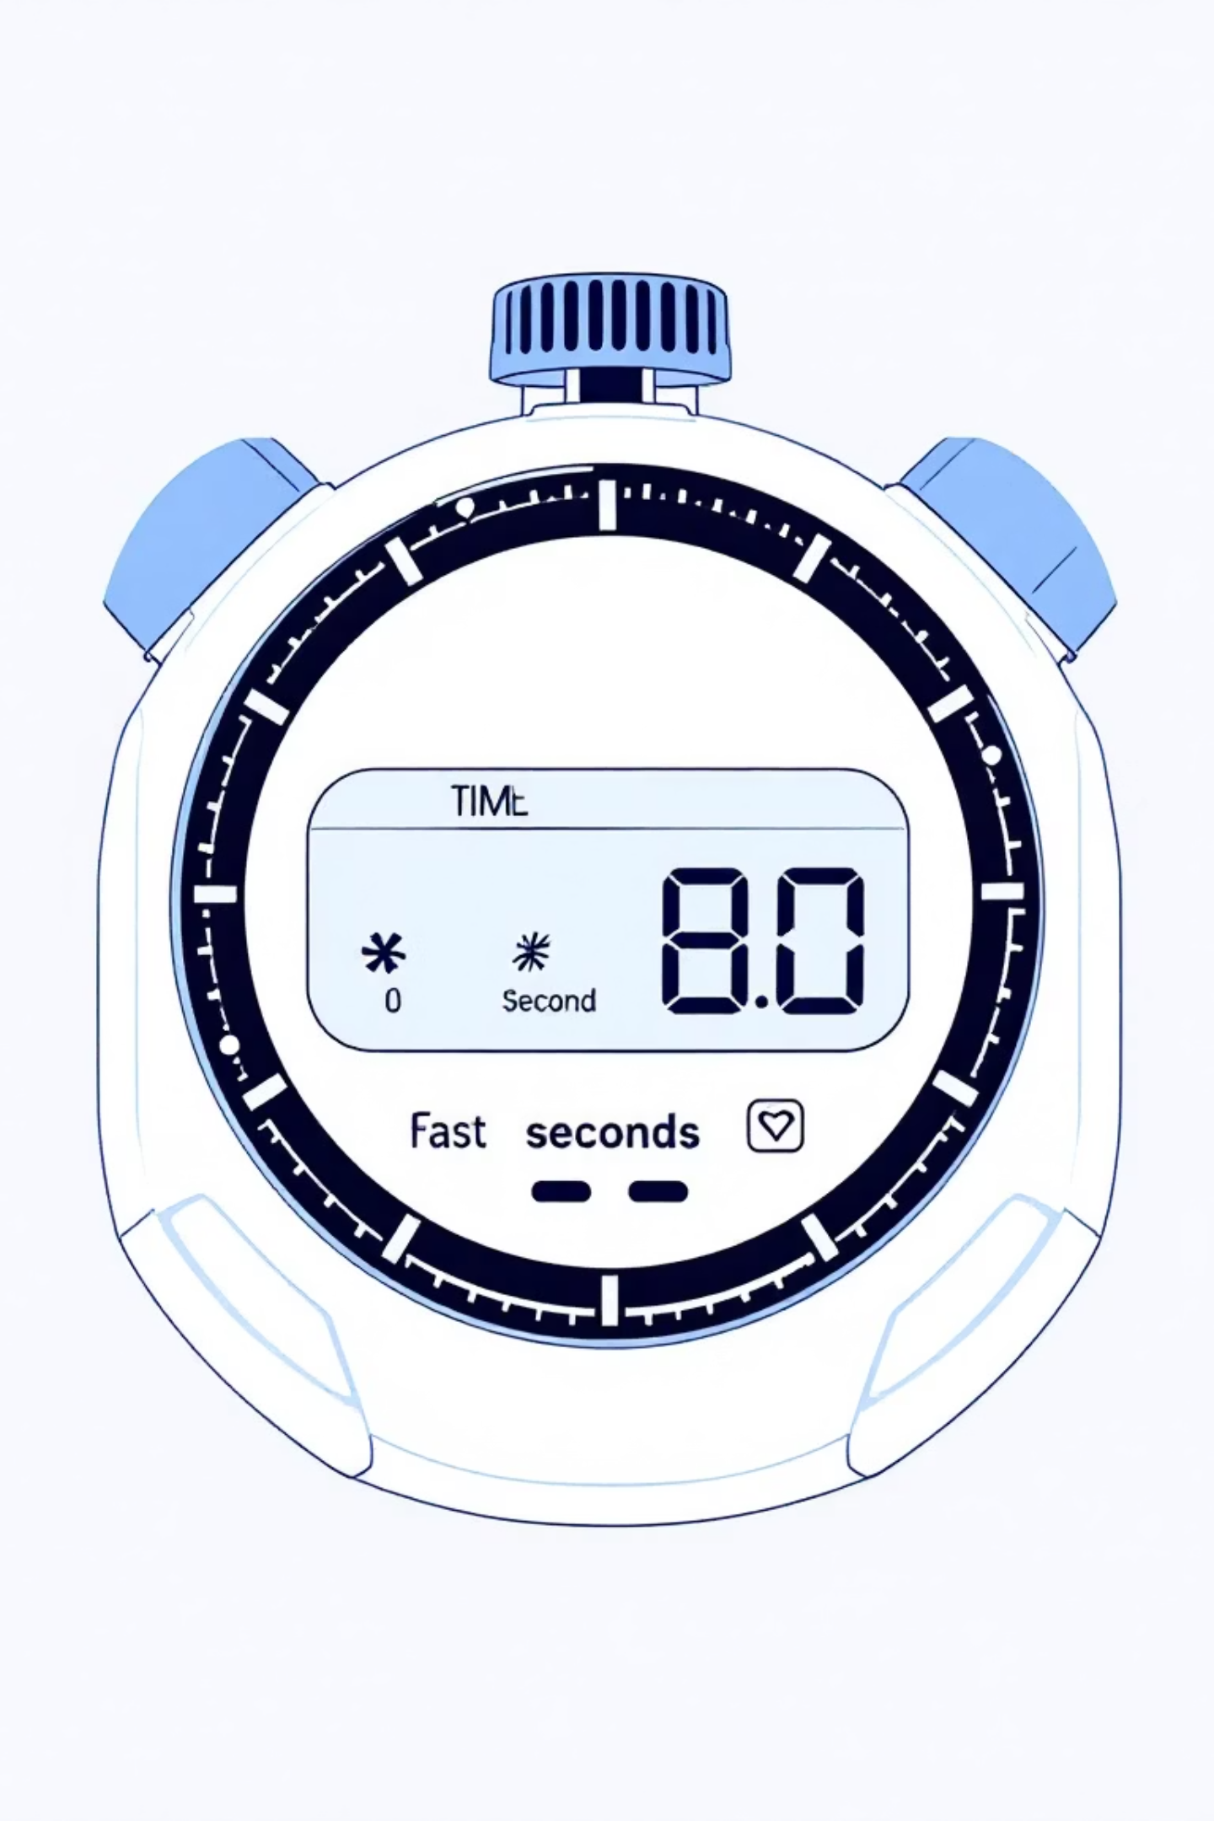




The Game-Changing Advantage
Prevention First
Stops accidents before they happen through enforced sobriety and helmet compliance
Instant Detection
Identifies crashes within milliseconds using advanced motion analysis algorithms
Rapid Response
Delivers precise location data to emergency contacts in just 8.2 seconds
Critical Insight: The difference between life and death in trauma situations is often measured in minutes. Our 8.2-second alert system reduces the traditional 4-minute response gap by 67%, giving victims a dramatically better chance of survival.

Slide 9

Future Vision: The Next Generation of Smart Safety
1
Mobile App Integration
Comprehensive rider dashboard for usage tracking, emergency contact management, and real-time location sharing with family members.
2
AI Riding Analytics
Machine learning algorithms analyze riding patterns to predict risky behavior and provide proactive warnings before accidents occur.
3
Solar Power System
Integrated solar panels eliminate battery concerns, ensuring the helmet remains powered indefinitely through renewable energy.
4
Health Monitoring
Biometric sensors track rider fatigue, heart rate variability, and stress levels to detect medical emergencies and drowsiness.

Slide 10
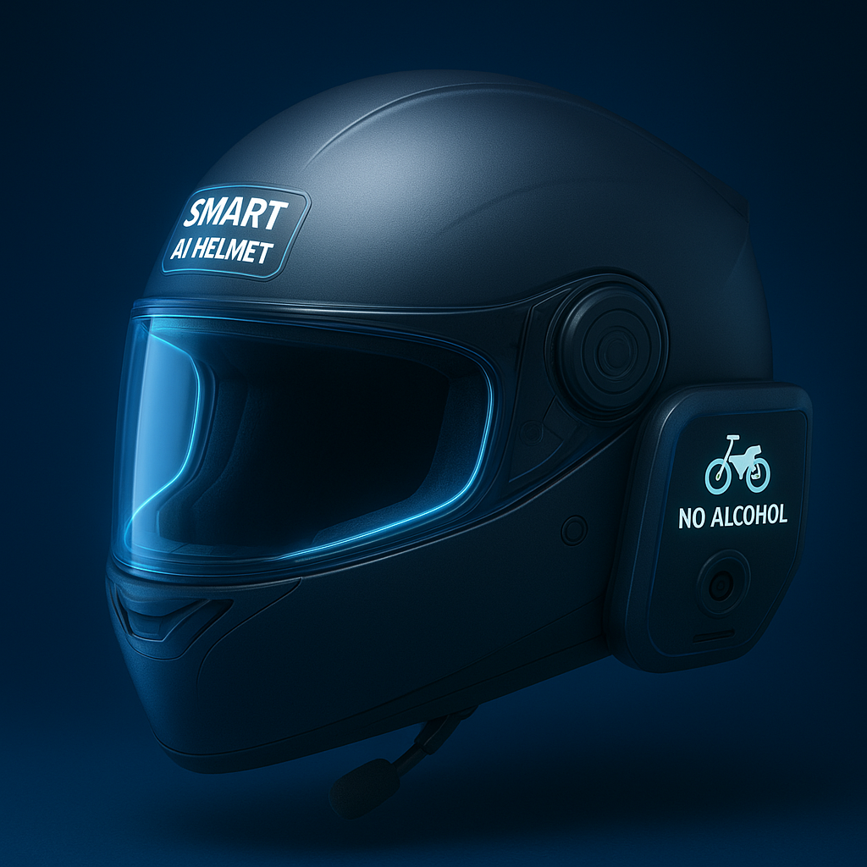



Engineering Innovation for Safer Roads
Project Objective
To design and analyze a Smart AI Helmet system that enhances rider safety through accident detection, alcohol sensing, and automatic emergency alerts.
Project Nature
This is a research-based project, focused on studying sensor integration, AI-assisted safety algorithms, and real-time communication systems — not a hardware prototype.
Research Outcomes
Conceptualized a cost-effective multi-sensor safety model.
Evaluated accident detection accuracy using motion analysis principles.
Proposed an alert mechanism using GPS-based emergency response.
Future Possibility
The research lays the foundation for developing a functional prototype that can be implemented using Arduino, GPS, and IoT modules for real-world testing.
T
The future of rider safety isn't just about protection—it's about prevention, instant response, and intelligent systems that watch over every journey.

